Slide 1
Verbal Communication Training
Analyst Showcase
OCTOBER 2024

Slide 2
Goals for Today
1
Review Basic Principles of Verbal Communication
2
Practice & Learn Together
3
Engage & Have Fun

Slide 3
Agenda
Goal of Communication
Principles
How to Improve

Slide 4
What’s the Goal of Communication?
“Putting your thoughts into someone else’s mind or vice versa”
Things it is:
Have your audience internalize your key takeaways
Influence your audience
Listening and internalizing your audience’s message
Receiving feedback from your audience
Things it’s not:
Have your audience know everything you explored, analyzed and considered in your work
An opportunity to talk a lot

Slide 5

Notes:
1 min – pause after “then we’ll know what you’re pitching…”
Let’s review an example of where communicating your idea and request properly is critical to achieving your goal.
What went well? (He made his ask of the audience clear up front, he spoke slowly with pauses)
What didn’t go well? (He added statistics that weren’t relevant to his audience, he never made it clear up front what the product does, he didn’t think about how certain information would resonate with the audience (i.e. women fishermen when there are 2 women in the audience))
Pass to Jack

Slide 6
Why is Communication Important in my Career?
Impact
Influence
Efficiency
Increased Usage as Career Progresses

Slide 7
Agenda
Goal of Communication
Principles
How to Improve

Slide 8
Principles of Good Verbal Communication
Be Concise
Use Structure
Emphasize your Objective or Key Takeaways
Read the Room
Good Stage Presence

Slide 9
Be Concise
Less is more
The more you talk the less your key idea shines
1
2

Slide 10

Be Concise Don’t be Like Abe
Notes:
https://www.youtube.com/watch?v=5Rzao52ndNA

Slide 11

Be Concise Exercise
Task: Who can most effectively and concisely communicate Why are Smartphones Useful?
Timing: Take 2 min to write down or practice your summary, we’ll then share back as a group
Notes:
Pass to Sarah

Slide 12
Use Structure
Keywords/Markers work just like bullets - they provide audience mapping of where thoughts are
Examples: First, Second, Lastly, Next, Then, Etc.
Numeric Markers are best since they provide a more specific mapping of where you are
2. Keeps Audience Engaged
Lack of structure → more words & confusing to follow → lost/unengaged audience
Unengaged audience doesn’t internalize key takeaways
1
2

Slide 13


Use Structure Example
“Why is good communication important to you?”
Slide Format
Title: Communication is important since it enables me to make an impact
Influence Decisions
Efficiency
Less back and forth
Time savings
Notes:
Good Communication is important since it enables me to make an impact. It does this in two ways. First, it allows me to influence decisions. Second, good communication is way more efficient – resulting in less back and forth, low-impact meetings and ultimately lots of saved time.”

Slide 14
Use Structure
Switching from Formal to Informal Communication: Informal communication also benefits from using structure
One Area of Informal Communication to Focus on is Q&A, a key part of the Analytics Showcase.
Tips:
1
Take a Pause to Structure Your Thoughts If you’re asked a question, take a moment before answering to think through how to answer in an organized way.
2
Delegate by Expertise Plan with your team ahead of time who might handle which types of questions. Anticipate what kinds of questions someone might ask on each topic.
3
How to Answer When You Don’t Know Don’t panic or make up an answer! In this forum, “I would look into that by…”, or “My hypothesis would be…” can be great tools.
Notes:
Pass to Jack

Slide 15
Emphasize your Objective or Key Takeaway
Presenting a Key Takeaway from Slide – State the key takeaway clearly at the beginning & end
1
Start by Reading Slide Title We spend time writing great slide titles, but then often don’t read them. It’s your key takeaway. Make sure it gets the air-time it deserves
2
Explain Charts/Graphs If audience isn’t familiar with the graph in the slide explain it, because otherwise your key point won’t land
3
Limit your other comments on the slide Your audience can read the slides details, don’t talk too much on the details of the slide as it will de-emphasize your takeaway
4
Re-emphasize Key Takeaway in Transitions Finishing a slide with key takeaway helps cement it in your audience’s mind

Slide 16
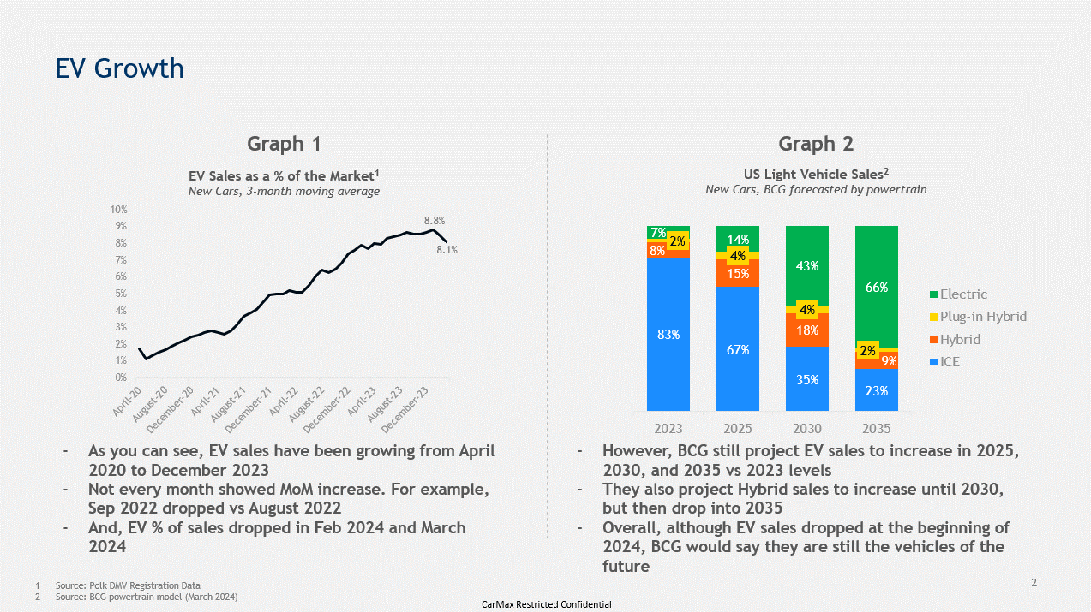
Emphasize your Objective or Key Takeaway Example
1
2
3

Slide 17
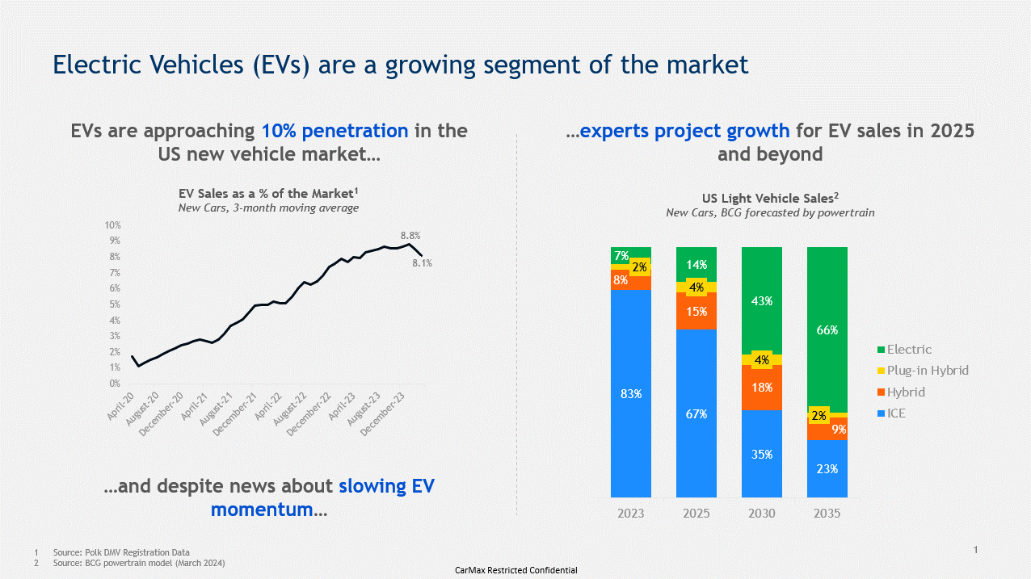
Emphasize your Objective or Key Takeaway Example
1
2
3
Notes:
Pass to Sarah

Slide 18
Read the Room
Look at everyone’s expressions You’ll be able to tell if people are tracking along
Remote Tip You can still do this on teams when presenting on teams – move your presentation to a second monitor, keep everyone’s videos up on the other screen.
Control how much you talk Use this downtime to observe the room
If your audience looks confused call an audible and clear things up
Engage audience directly: e.g. “Jack – you look like you have a question”
Slow down and repeat content
1
2
3

Slide 19

Read the Room
If your audience looks like this – you need to regain their attention.
Directly engage your audience somehow - ask a question to the group or call on someone
Ramp up your energy level
Make a joke
4
Notes:
Pass to Jack

Slide 20
Good Stage Presence
Be Confident
Use a strong, firm voice/tone to state opinions
Use direct language
If asked “What is your recommendation?”
Good: We should do XY&Z
Bad: I guess if I had to choose I’d lean towards XY&Z
Good posture and non-verbals
But don’t be arrogant or overly confident
Be Expressive
Communication can be fun – make jokes, vary your tone where appropriate
Use your facial expressions – smile, look excited, etc.
Good Cadence
Go relatively slow
Pause between key points
1
2
3

Slide 21
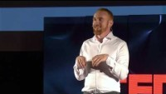
https://youtu.be/K0pxo-dS9Hc?t=86
Notes:
1.5 min – “stop at nothing about these 110…
Pass to Sarah

Slide 22
Principles of Good Verbal Communication Review
Be Concise
Less is more
More means your key takeaways don’t pop
Use Structure
Critical to helping audience track along with you
Use marker words (e.g. First, Second)
Emphasize your Objective or Key Takeaways
Start by Reading the Title (aka your key takeaway)
Explain graphs/charts; helps audience internalize key takeaway
Re-emphasize takeaways at the end of section
Read the Room
Do they look confused? Bored? Engaged?
Adjust accordingly – the reason you’re communicating is so they understand
Good Stage Presence
Be Confident and Expressive
Good Cadence

Slide 23
Reflection Exercise
Task: Based on these principles, reflect on a recent presentation. What went well? What didn’t? Reflecting on your recent communication reps, where do you want to focus on improving?
Timing: Take ~2 min to reflect silently and record any observations

Slide 24
Agenda
Goal of Communication
Principles
How to Improve

Slide 25
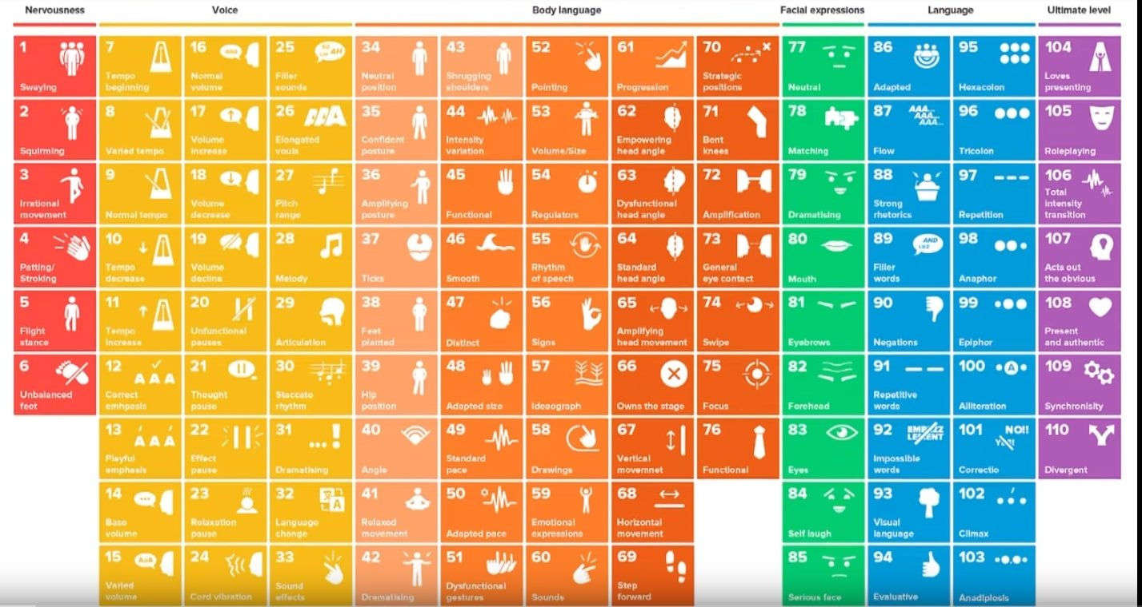
Good Verbal Communication is a Skill, Not a Talent
For 7 years, David JP Phillips studied 5000 public speakers to identify 110 presentation skills than can be learned to improve your verbal communication
It’s not necessary to master all of these skills, but what his research shows is that there are very specific actions you can practice to improve

Slide 26
Practice & Reflection will drive significant improvement
Being a good communicator isn’t easy. But it’s a skill almost anyone can be good at. It just takes lots of practice, reflection & commitment
Think back on presentations you’ve done – review the principles. Did you follow them?
Did your teammates jump in and say things while you presented? It’s probably because you missed something – reflect on why they might have jumped in
Practice your presentations & structuring of responses - have someone else watch and provide feedback, record yourself, or use PPT’s new “Rehearse with Coach” tool
Ask someone watching the presentation to be your “mole”; share your communication goals with them and follow up to get specific feedback afterwards
1
2
3
4
What other techniques have helped you develop verbal communication skills?
Notes:
Pass to Sarah

Slide 27
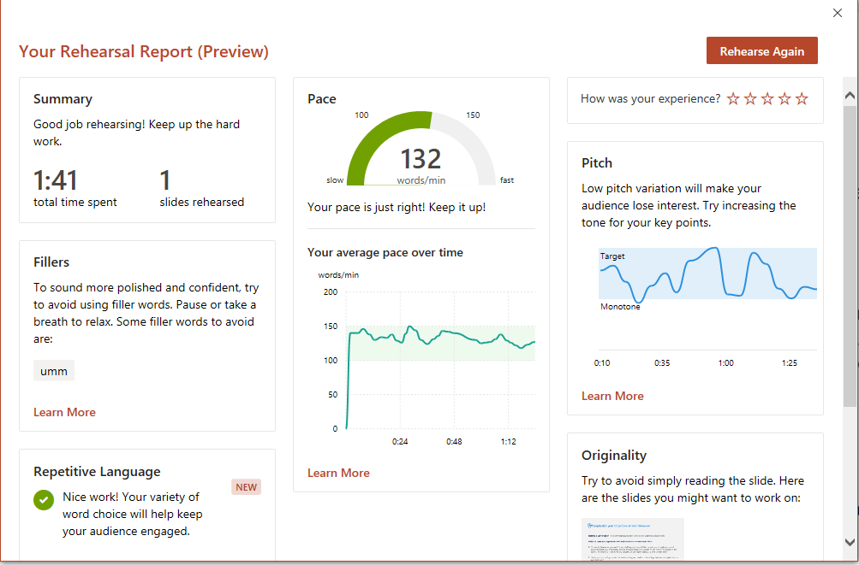
Rehearse with Coach gives you real-time feedback on your verbal communication skills
This feature can be accessed via the PPT Ribbon: Slide Show > Rehearse
Notes:
End

Slide 28
Q&A

